Slide 1
Bridge Inspection Robot Proposal Presentation
Sean Csukas
Kristen Fernandez
Erikzzon Latoja
Justin Tamayo
Sanmeshkumar Udhayakumar
Advisor: Dr. Patricio Vela

Slide 2
Introduction
The team will design a wireless sensing robot for structural health monitoring of steel structures
Replace the old flexure-based, four-wheeled robot with a design that features upgraded electrical and mechanical components along with increased mobility

Slide 3
Goals and Stretch Goals
Goals
Ability to horizontally and vertically traverse steel bridges
Measure bridge vibrations at low frequencies
Wirelessly transmit vibration data to a PC
Holding weight strong enough for future module attachments
Light enough for deployment and retrieval by drone
Stretch Goals
Complex Path following

Slide 4
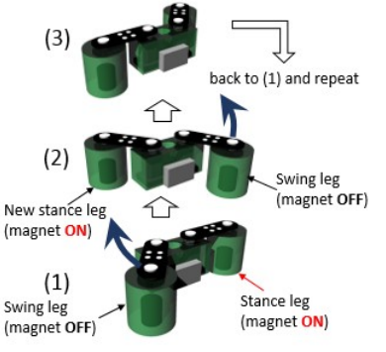
Mobility: Legged Design with Joints
Two legs attached with joints to a rigid body
Electromagnets at the “feet”
Servos placed at the joints move robot through waddling action
Pros
Can turn any angle in one movement
Cons
Cannot traverse inclines or corners
Feet will scrape floor during movement
Requires more movement controls
Mechanical complications

Slide 5
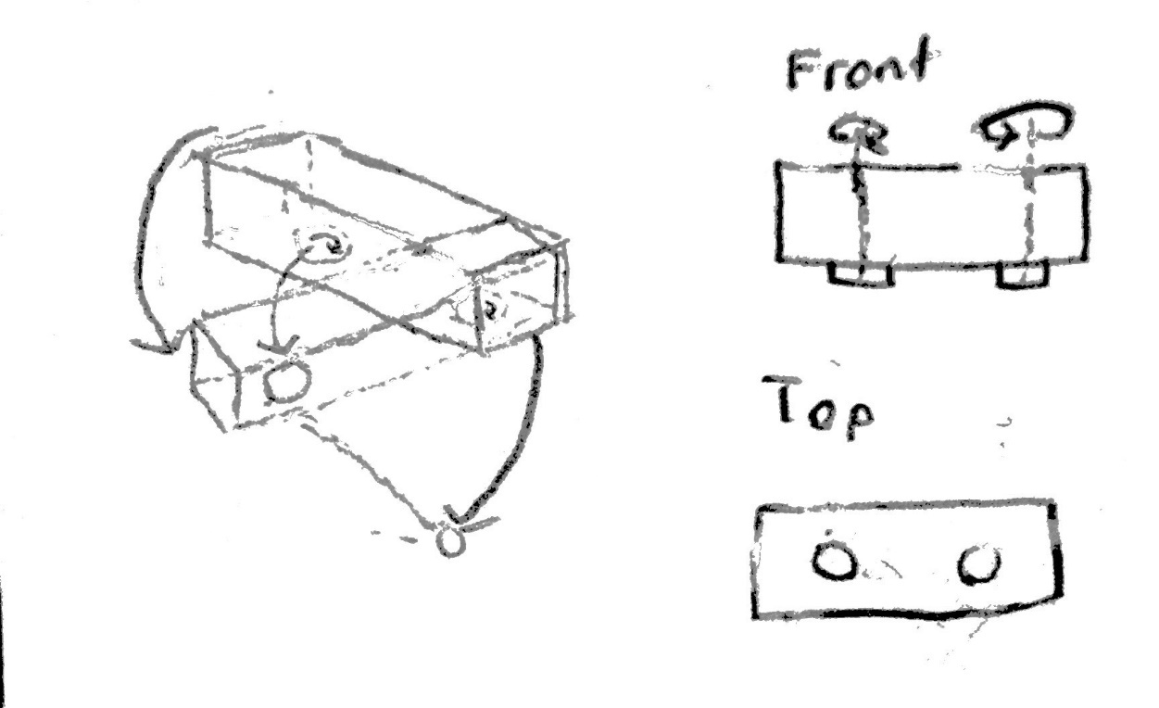
Mobility: Legged Design without Joints
Two legs attached without joints to a rigid body
Electromagnets at the “feet”
Servos placed in the legs move robot through waddling action
Pros
Can turn any angle in one movement
Mechanically simplified
Cons
Requires more movement controls
Cannot traverse inclines or corners
Feet will scrape floor during movement

Slide 6
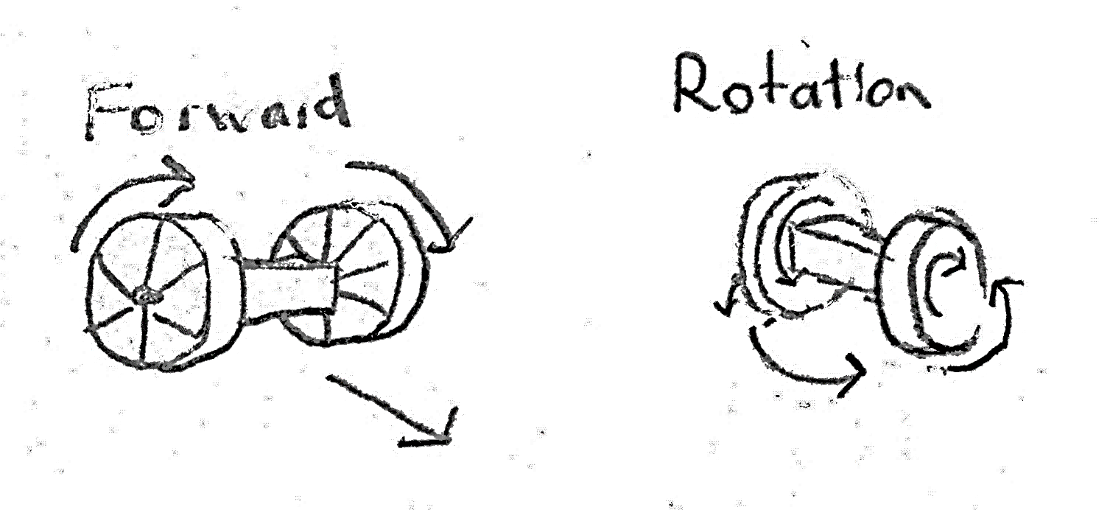
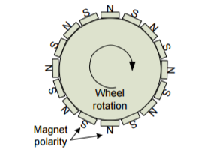
Mobility: Two-Wheeled Design
Rigid body between two wheels
Permanent magnets surround wheels
Pros
Simple movement controls
Fast traversal of linear paths
More power efficient
Able to climb inclines
Rotate in place
Cons
Body will not stay parallel to surface on inclines – requires additional system for accelerometer deployment
Magnets will keep wheels stationary when motors are driven

Slide 7
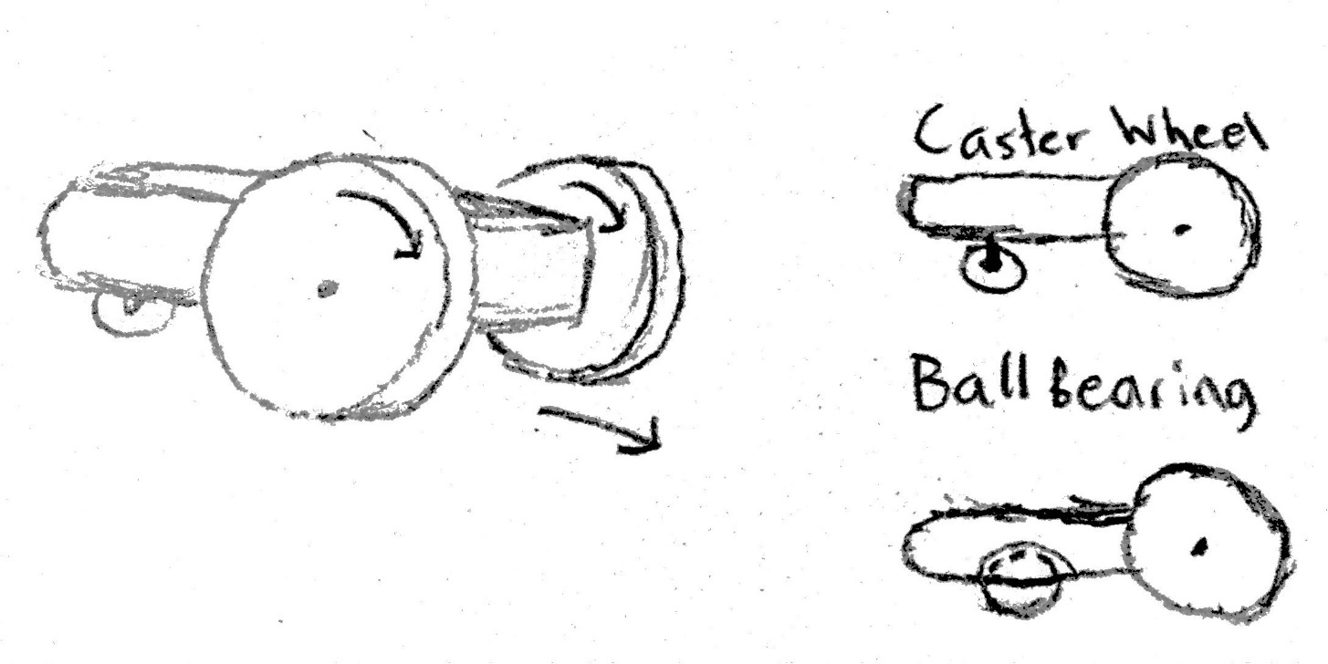
Mobility: Three-Wheeled Design
Two motorized wheels in the front and a passive caster wheel/ball bearing at the back
Permanent magnets surround motorized wheels
Permanent magnet placed above ball bearing or around caster wheel
Pros
Retains pros of previous design
Solves movement problem of two-wheeled design
Cons
Third wheel or bearing is a more complex implementation

Slide 8
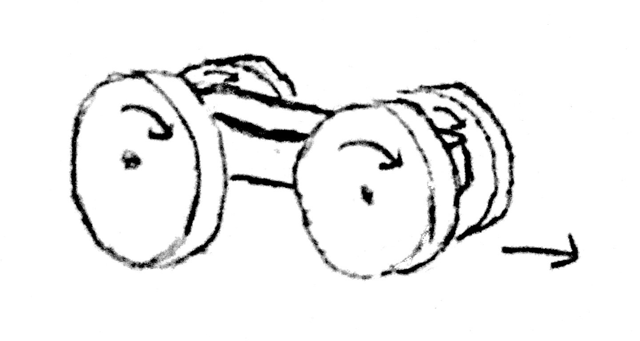
Mobility: Four-Wheeled Design
Single rigid body with two motorized wheels in front and two motorized wheels in the back
Permanent magnets surround wheels
Pros
Smaller form factor
Stable
Cons
Higher weight and power consumption from extra motors
Wheel width must be thin enough to allow slippage during turning but thick enough for magnetic forces

Slide 9
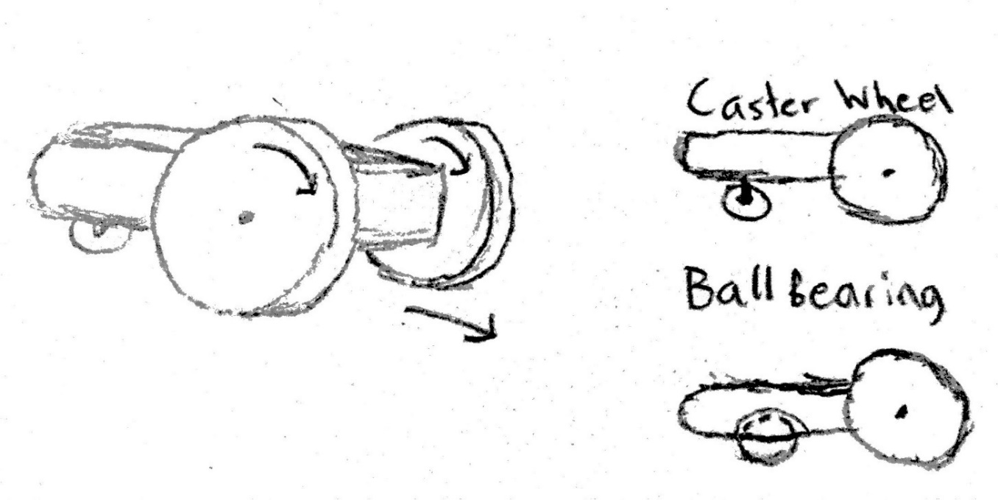
Mobility Choice: Three-Wheeled Design
Overcomes forward movement problem of two-wheeled design
Retains all the pros of the two-wheeled design
Less weight and power consumption compared to four-wheeled design

Slide 10
Motion Requirements
For this design, weight and power consumption need to be minimalized
RPM can be relatively low since the robot does not need to traverse the bridge extremely fast
A four inch wheel turning at 60RPM would travel ~20m per minute
Moderate to high torque will be needed for angles up to 90°
There are not major space constraints on the motor
One motor would be required for each driven wheel
Encoder would be required, either built-in or as a separate module

Slide 11
Motor Options
Motor Name | Motor Type | Operating Voltage | Current Draw | Torque | Speed | Interface | Weight
Dynamixel Ax-12 | Servo | 9V-12V | 50mA/900mA | 15.3kg-cm | 59 RPM | Async Serial | 55g
Futaba S3003 | Servo | 4.8V-6V | 8mA/400mA | 4.2kg-cm | 52 RPM | Analog | 44.2g
Tower Pro MG995R | Servo | 4.8V-6V | 30mA/400mA | 10kg-cm | 62 RPM | Pulse | 55g
Micro Gear Box Motor | BDC | 12V | 110mA/800mA | 4kg-cm | 100RPM | PWM | 193g
Pololu 37D metal gearmotor | BDC | 6V 12V | 250mA/2.5A 300mA/5A | 9kg-cm 18kg-cm | 80RPM 40RPM | PWM | 205g
Pololu 25D metal gearmotor w/ encoder | BDC | 12V | 100mA/1.1A | 6kg-cm 8kg-cm … | 71RPM 55RPM … | PWM | 104g

Slide 12
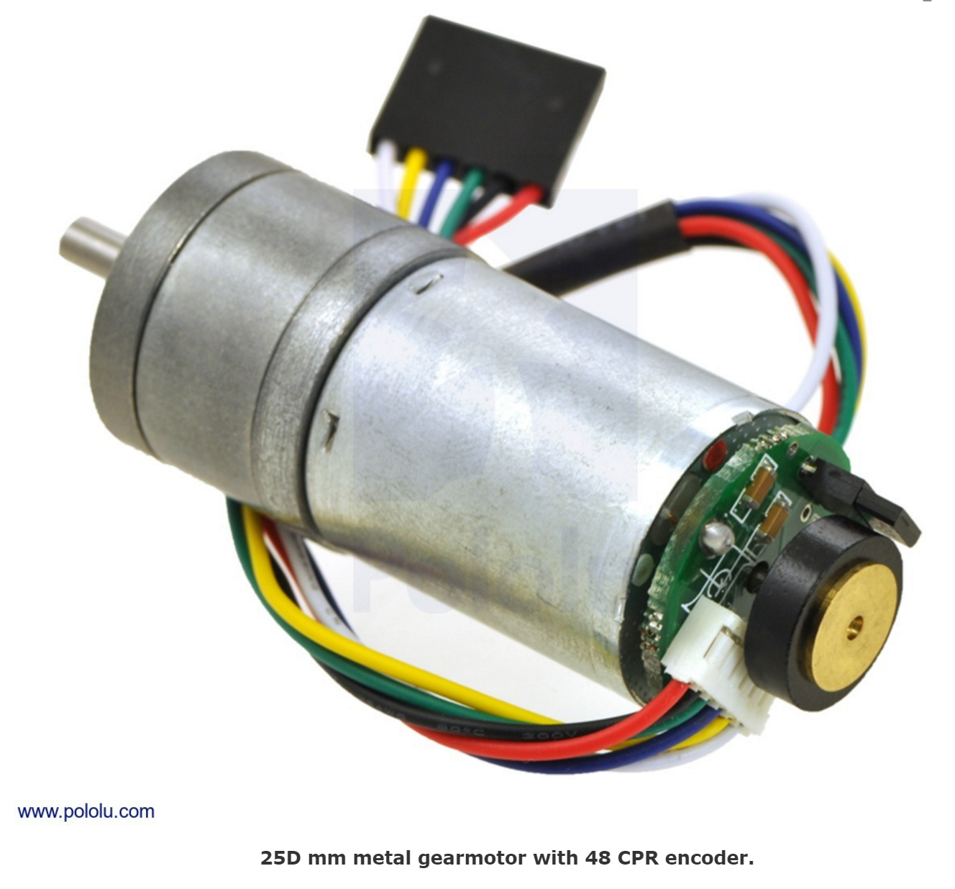
Motor Choice
The Pololu 25D metal gearmotor with encoder is our ideal motor
The motor comes with a large variety of gear reduction options providing outputs ranging from 0.144 kg-cm at 5600 RPM to 23kg-cm at 100 RPM
The motor also offers 3 power options, High, Medium and Low power at 12V

Slide 13
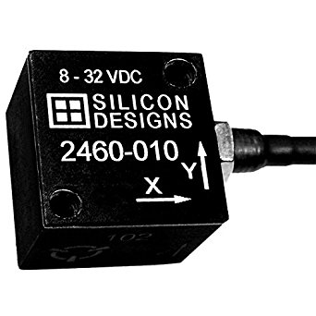
Accelerometer: Silicon Designs 2460-002
3-Axis version of the original Model 2012-002
Significant lateral vibrations noted alongside vertical vibrations on the MARC bridge during previous testing
Input Range: ± 2 g
Frequency Response: 0 – 300 Hz
Differential Sensitivity: 2000 mV/g
Input Voltage: 8 – 32 VDC
Operating Current: 19 – 27 mA DC
Mass (without cabling): 21 g

Slide 14
Accelerometer Deployment Method
Requirements
Accelerometer shall mount directly onto bridge
Accelerometer shall be flush with bridge to ensure accuracy of measurements
Design must incorporate vertical motion w.r.t. the Bridge Inspection Robot frame

Slide 15
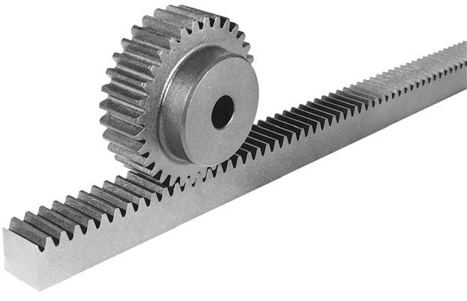
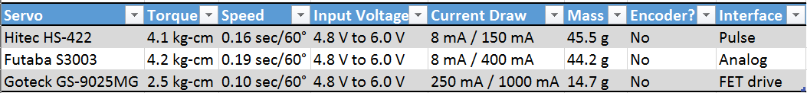
Method 1: Rack & Pinion
Pros
Low torque and power requirements
Simple design concept
Cons
No existing prepackaged solution
Rack adds excess weight

Slide 16
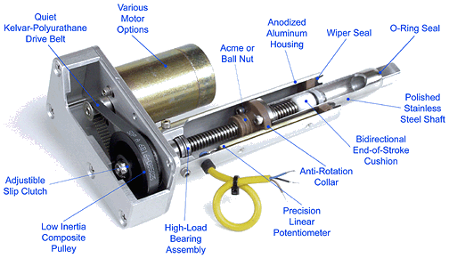
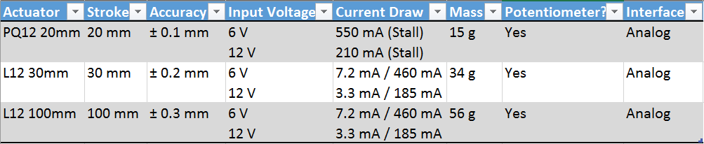
Method 2: Linear Actuator
Pros
Store-bought plug-and-play piece
Less mass than rotary actuator for rack & pinion method
Cons
Expensive to purchase
Vertically space consuming

Slide 17
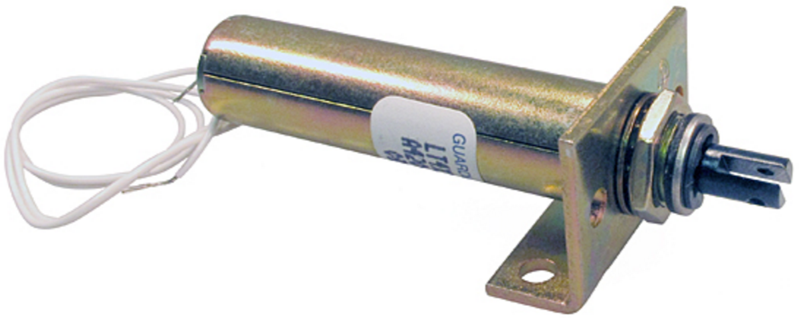
Method 3: Solenoid
Pros
Fast actuation from robot to bridge and back
Easy start and stop indications for data collection
Cons
No holding force, may be difficult to ensure proper contact
High power consumption
Actuator | Stroke | Input Voltage | Watts | Mass | Interface
Series S-20-90-H | 50.8 mm | 12.1V | 9W | 155g | DC

Slide 18
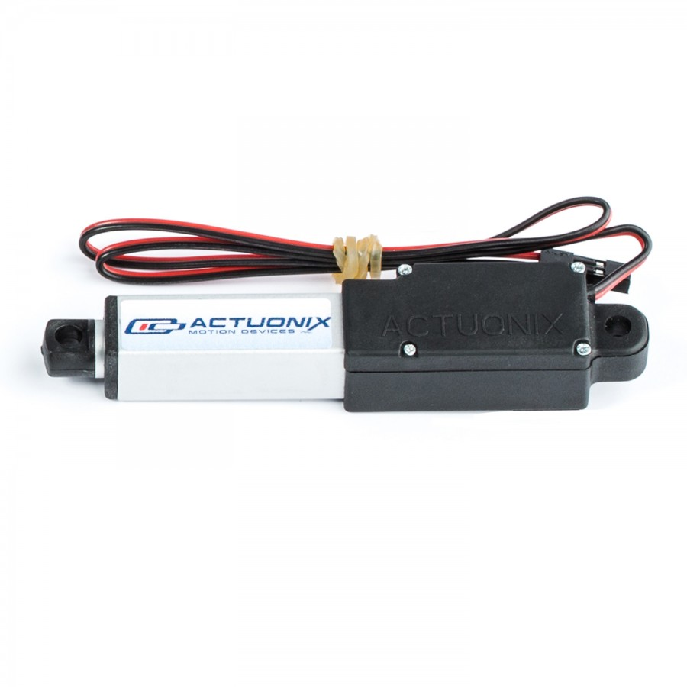
Design Decision: Linear Actuator
Actuonix L12 30mm Linear Actuator
Prepackaged solution
Very low mass
Potentiometer already available for control
May explore Rack & Pinion further if Mechanical Engineer joins team or if complications occur

Slide 19
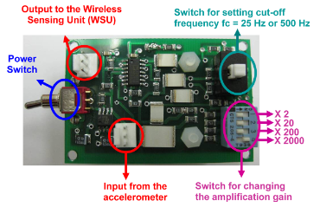
Accelerometer Signal Conditioning Module
Prior testing showed structural vibrations yielded peak amplitude of only 0.125 mV at a vibration amplitude of 0.001 m/s^2
Susceptible to circuitry noise
Difficult to digitize with standard A/D Conversion
Custom Signal Conditioning Module used in previous design
Amplifies and conditions signal before A/D Conversion
Receiving support from Dr. Wang for updating the current module to work with new accelerometer

Slide 20
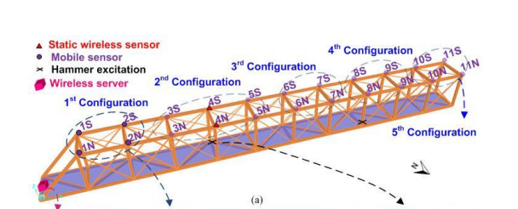
Motion Tracking Requirements
Assumptions
Initial orientation is known
Only straight path traversal is required for the most part, with turning used for path corrections
Requirements
Need to go in a roughly straight path so robot won’t need to continuously correct path
Need to be able to detect edges so robot won’t fall off
Need to be able to identify locations of structural health measurements to around about 2m resolution fairly accurately as in experiment in thesis paper

Slide 21
Requirement 1: Straight Path
Need to go in a roughly straight path so robot won’t need to continuously correct path (only yaw is considered)
Possible Solutions:
Gyroscope
Pros: Cheap, simple data
Cons: No constant reference, just measures change of angle so error can accumulate
Magnetometer (basically compass):
Pros: Cheap, simple data, constant reference of earth magnetic field
Cons: Magnetometer reference will be skewed by permanent magnets on wheels
Encoders
Pros: Cheap, simple data, probably not much drift due to permanent magnets holding the wheels well to the bridge, can be used for path correction by spinning one wheel more than other
Cons: Still potential for drift and no constant reference

Slide 22
Requirement 1: Straight Path Cont.
Proposed solution:
Use Encoders on motor
Stretch Goal:
Implement gyroscope as well
Will buy gyroscope and make sure gyro data is at least accessible

Slide 23
Requirement 2: Edge Detection
Need to be able to detect edges so robot won’t fall off
Possible Solutions
IR Sensors
Pros: Implemented before, simple output, cheap
Cons: Color of bridge could affect edge detection capabilities (may need to adjust thresholds for an edge "hit" from bridge to bridge)
Ultrasonic sensors
Pros: Color no longer an issue
Cons: Generally more expensive than IR Sensors, sound-absorbent material blinds the sensor

Slide 24
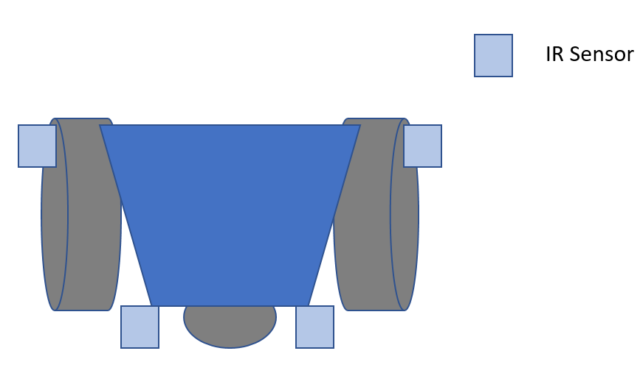
Requirement 2: Edge Detection cont.
Proposed Solutions
IR Sensors
Four IR sensors mounted close to wheels and near edge
Will verify that wheels will hit inclines so that sensors will not scrape against surfaces
IR

Slide 25
Requirement 3: Motion Tracking
Need to be able to identify locations of structural health measurements to around about 2m resolution fairly accurately as in experiment in thesis paper
Possible Solutions
Solely Encoders
Pros: Already on robot for previous requirements so dual purpose
Cons: Encoder measurements not absolute so drift over long range
GPS
Pros: Absolute reference of position, pretty accurate (2m resolution)
Cons: Won’t work in regions with poor receptions and under the bridge
Separately bought IMU
Pros: Very accurate for small movements, can potentially localize, and all filtering and sensor data-fusion already done
Cons: Not accurate over large distances, can be expensive
Use existing accelerometer in conjunction with encoders and gyroscope
Pros: Very accurate for small movements, save money and weight by using sensors already needed for robot
Cons: Need to implement filtering, sensor data fusion, and movement interpolation ourselves

Slide 26
Requirement 3: Motion Tracking Cont.
Proposed Solutions
Implement Now: Use encoder movement, combined with GPS for absolute position recalibration every 2m
Pros: Removes drift of encoder, when under bridge can rely purely on encoders
Cons: Extra part
Future: Incorporate accelerometer and Gyroscope for extra position verification, and discard GPS
Pros: Less cost
Cons: Harder to implement accurately

Slide 27
Gyroscope
Name | # of axes | Price | Resolution | Accuracy | Power Draw | Interface | Other
SparkFun Triple-Axis Digital-Output Gyro Breakout - ITG-3200 | 3 | $24.95 | ± (2000°/sec)/(2^16) = ± .0305°/sec | Zero Bias: ± 40°/s | 23.4 mW | I2C | user-selectable internal low-pass filter bandwidth. Fast-Mode I2C (400kHz). Temp sensor. Optional external clock inputs of 32.768kHz or 19.2MHz to synchronize with system clock
ST L3GD20H | 3 | $3.42 | ±245/±500/±2000°/s with 16 bits | Zero Bias: ±25°/s | 15 mW | I2C/SPI | User enabled integrated low-pass and high-pass filters. Temp sensor.
SparkFun Tri-Axis Gyro Breakout - L3G4200D | 3 | $49.95 | ±250/±500/±2000°/s with 16 bits | Zero Bias: ±245/±500/±2000°/s | 21.96 mW | I2C/SPI | Integrated low- and high-pass filters with user-selectable bandwidth

Slide 28
GPS
Name | Price | Accuracy | Update Frequency | Sensitivity | Power | Interface | Other
Adafruit Ultimate GPS Breakout - 66 Channel MTK3339 | $39.95 | 1.8 m | 10 Hz | 165 dBm | 100 mW | Serial Comuniation | Comes with breakout board. Has in-built data-logging. SMA connector to connect external antenna.
GPS Bee with Mini Embedded Antenna | $16.00 | 2.5 m | 4 Hz | 160dBm | 200 mW | UART, USB, DDC and SPI interfaces | SMA connector to connect external antenna.
Venus GPS with SMA Connector | $49.95 | 2.5 m | 20 Hz | 165dBm | 297 mW | UART, SPI | Internal flash for optional 75K point data logging. SMA connector to connect external antenna.

Slide 29
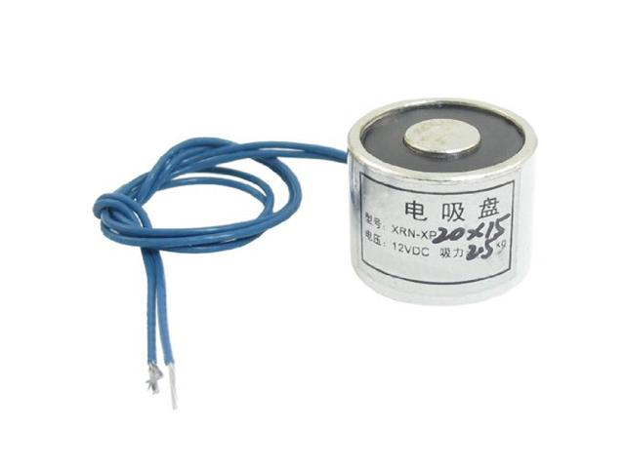
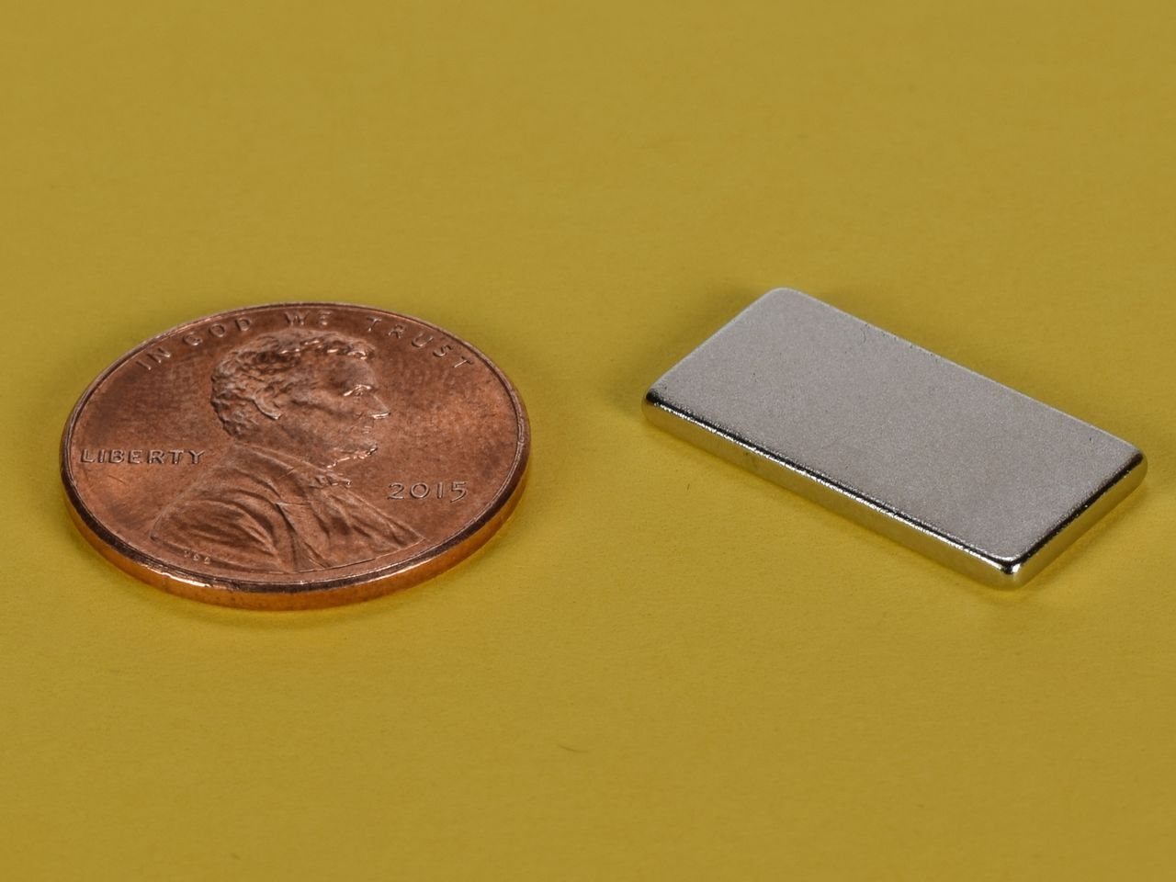
Magnets
Electromagnet
Example specifications
20x15mm
12VDC @ 0.25A
Strength: 5.5 lb.
Permanent magnet (neodymium)
Example specifications
No power cost
3/4" x 3/8" x 1/16"
Strength: 3.86 lb.

Slide 30
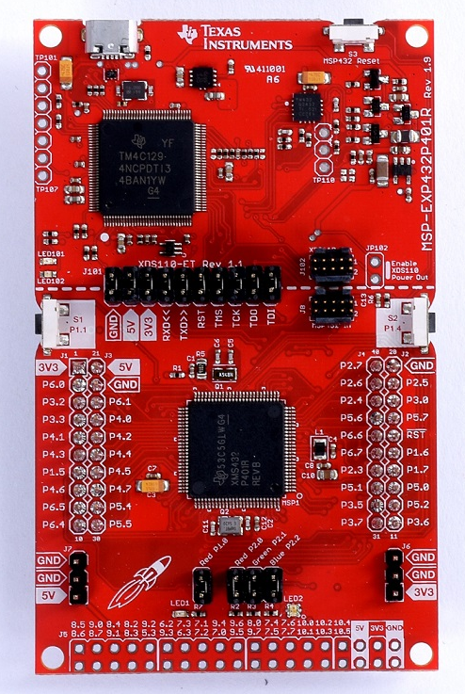
Microcontroller – TI MSP432P401R
Specifications
48 MHz ARM 32-bit CPU
256 kB of flash memory
64 kB SRAM
14-bit ADC
Current draw (active mode, typical): 7.8 mA
Programmed via Code Composer Studio IDE
MSP432 Launchpad will be used for rapid prototyping
Surface-mounted MSP432 will be incorporated into final design
Notes:
Compared to MCU of previous robot: 8 Hz 8-bit MCU, 128 kB flash, 4 kB SRAM, 10-bit ADC, 17 mA current draw
Kristen and Justin have previous experience using this MCU

Slide 31
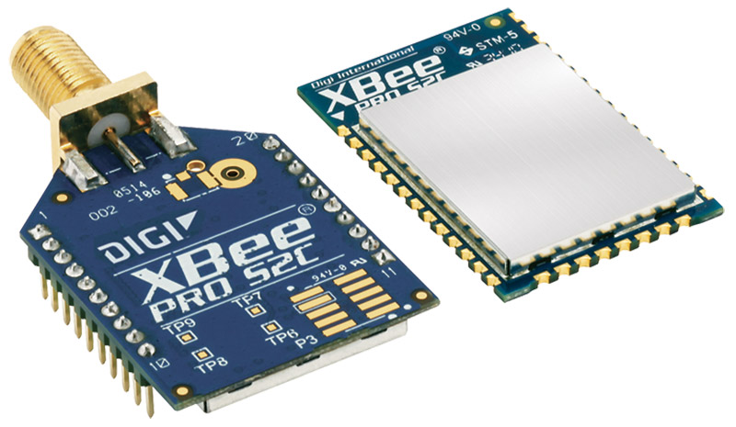
Wireless Module - XBee S2C DigiMesh 2.4
Specifications
Max outdoor range: 1200 m
Throughput: up to 250 Kbps
Data payload per frame: up to 256 Kbps
Interface: SPI
Current draw (typical): 28-33 mA
Wireless Protocol: Digimesh
Raw conditioned data will be sent to PC for post-processing
Notes:
Outperforms the wireless module of the previous robot in all aspects - range, throughput, current draw, etc.

Slide 32
Power Requirements
Power requirements will be mainly dependent on the following:
Motors
Wireless
Accelerometer
Acc Deployment
The robot is expected to run for at least one hour actively and an additional hour stationary
The robot will require a maximum voltage of 12V to accommodate the accelerometer and motors. Power conversion circuitry will be used to create lower voltages for other components

Slide 33
Battery Options
Battery Type | Voltage Rating | Capacity | Recharge? | Weight | Vendor
Alkaline AA | 1.5V | 1000mAh | No | 23g | Duracell
Alkaline 9V | 9V | 500mAh | No | 45g | Duracell
Ni-Mh AA | 1.2V | 2600mAh | Yes | 26.5g | Tenergy
Ni-Mh AAA | 1.2V | 1000mAh | Yes | 13g | Tenergy
Ni-Mh 9V | 9V | 250mAh | Yes | 86g | Tenergy
NiCd AA | 1.2V | 1000mAh | Yes | 27g | Tenergy
Li-Ion | 3.7V | 3000mAh | Yes | 45g | EBL
Li-Ion | 9V | 600mAh | Yes | 30g | EBL
Lipo 3S | 11.1V | 2200mAh | Yes | 170g | Turnigy
Lipo 3S | 11.1V | 5000mAh | Yes | 489g | Turnigy

Slide 34
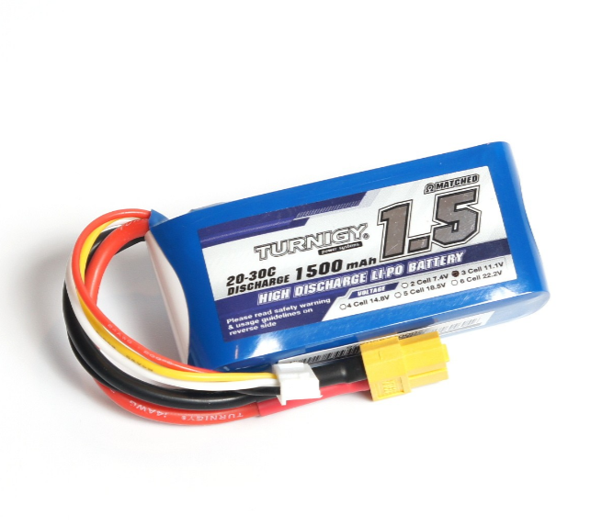

Battery Choice
Ni-Mh AAA (10 in series) or Lipo 3S
The Lipo can provide a higher continuous current and doesn’t need several in series, but would need a special charger

Slide 35
Structure
A holding structure will be needed for the battery and circuitry
It can be rapidly prototyped using Inventor 2017 and 3D printing with the Senior Design Lab
A chassis is needed to support the motors and previously mentioned holding structure. Aluminum or acrylic sheets will be cut for a high strength support. This can also be designed in Inventor 2017 and machined at the invention studio
Both of these tasks will likely require assistance from and mechanical engineer

Slide 36
Circuit Design
The design will use a single circuit board for power, data transmission, and motor control
It will be designed in using the educational license of Autodesk Eagle
Printing will be completed professionally by one of the following:
Advanced Circuits - $33, 2 layer board up to 4”x6”, 2 week turnaround
OSH Park - $5/sq-in for three boards, 12 day turnaround
Senior Design Lab– Potentially free, 10 day turnaround

Slide 37
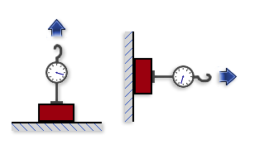
Verification – Holding Force
Holding force of magnets will be verified by measuring the amount of time a magnet can maintain its position in different configurations
Requirement is verified if magnets can maintain their position with a 1kg mass attached at various locations for at least 2 minutes

Slide 38
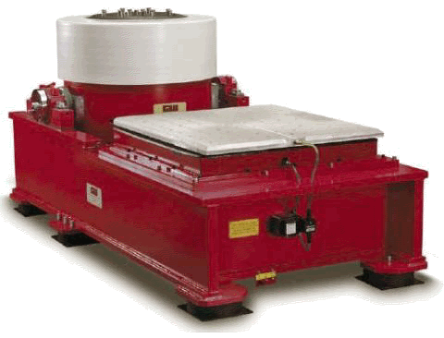
Verification – Accelerometer Data Accuracy
Verification of the accelerometer data accuracy will require usage of a shaker table
A vibration profile will be measured by mounting both a statically mounted accelerometer and the robot with its installed accelerometer on to the table

Slide 39
Verification – Battery Life
Battery life analysis will be divided into traversal lifetime and holding lifetime
Traversal lifetime will be measured by having the motors drive continuously on metal surface as if it were traversing a bridge until the battery runs out
Holding lifetime will be measured by having the robot collect ambient vibration data until the battery runs out
Requirements will be met if each lifetime surpasses one hour

Slide 40
Verification – Wireless Communication Distance
The robot shall send data at distances varying linearly from 500m to 1000m to a base computer
Communication distance is verified if it can accurately send data at least 800m away from the computer

Slide 41
Final Demonstration
The robot will be placed on the bridge located at the MRDC and be expected to traverse to one of the measurement locations in each configuration
At each configuration, the robot will take measurements at one location simultaneously with stationary sensors at the remaining locations and send the data to the base computer
Measurement accuracy will be further confirmed by striking the bridge with a hammer during measurements

Slide 42
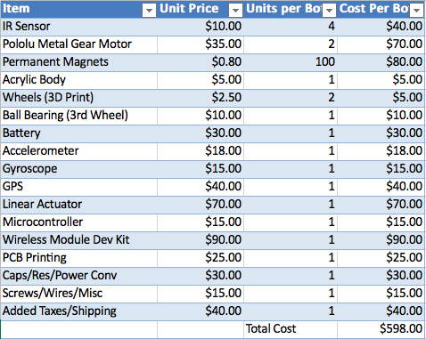
Cost Analysis

Slide 43
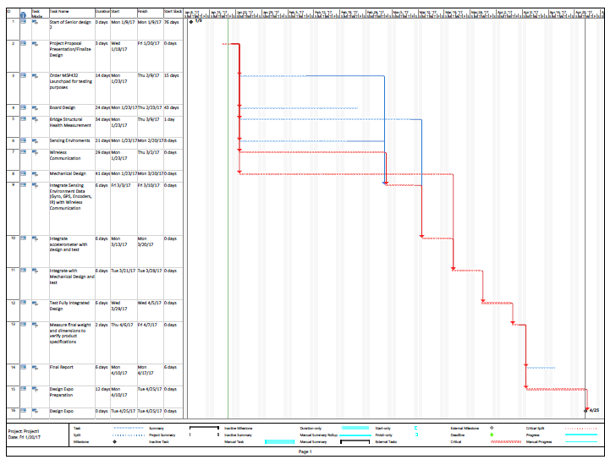

Slide 44
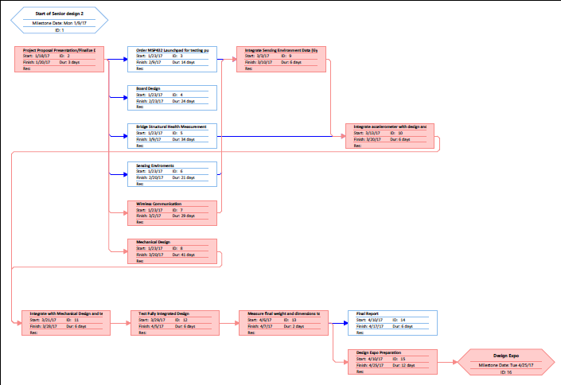

Slide 45
QUESTIONS?

